Slide 1
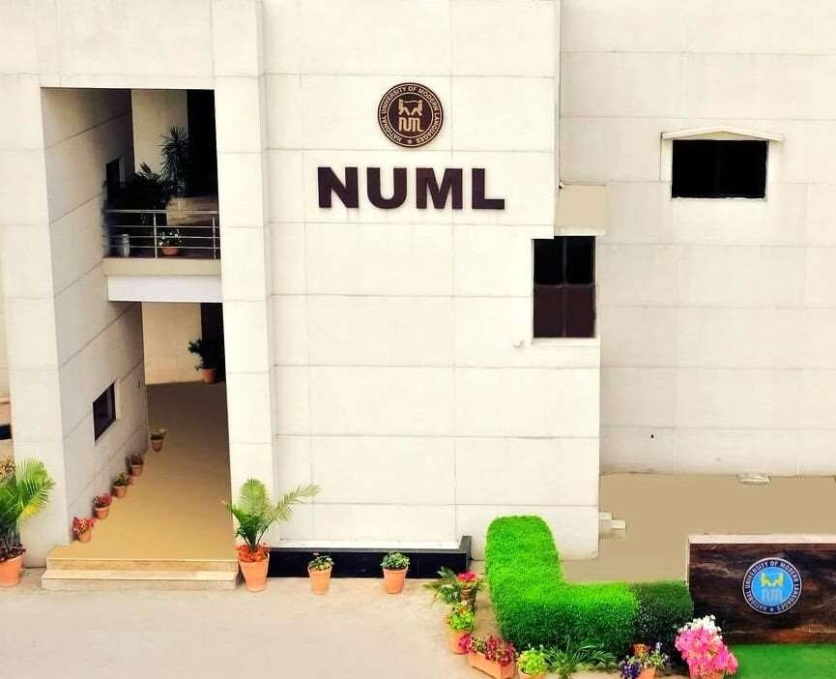
The Complete Story of Syed Babar Ali Entrepreneur
Presented By:
M Haseeb Haider
Presented to:
Sir Zaheer Abbas Kazmi

Slide 2
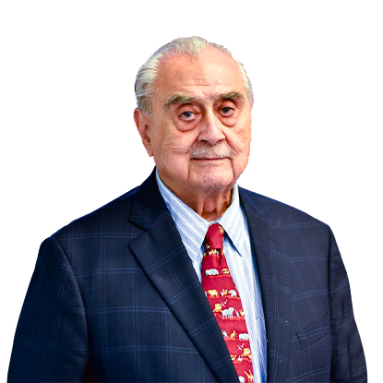
Who is syed babar ali?
Syed Babar Ali is a renowned Pakistani businessman and philanthropist, best known for founding some of the country’s most prestigious institutions.
He is the founder of Lahore University of Management Sciences (LUMS), one of Pakistan’s leading business schools.
Born | January 15, 1926, Lahore
Father | Syed Maratib Ali – Industrialist, Contractor
Heritage | Maternal link to Afghan Royalty
Neighborhood | Mochi Gate, Walled City, Lahore – hub of traditional commerce

Slide 3
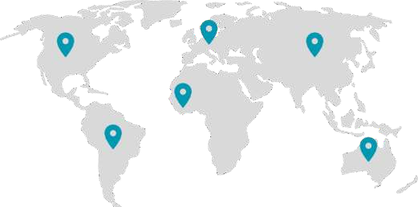

Introduction to National Foods
Institution | Location | Years Attended | Notable Impact
Sacred Heart School | Lahore | Early 1930s | Early academic foundation
Aitchison College | Lahore | Until 1945 | Elite grooming, networking
Government College | Lahore | 1945 | BSc in Physics & Chemistry
University of Michigan | Ann Arbor, USA | 1947 | Business studies (returned post-Partition)
Harvard Business School | Boston, USA | 1973 | 13-week Advanced Management Program

Slide 4

Business Ventures Overview
Packages Ltd. (1956): JV with Akerlund & Rausing (Sweden), paper & packaging pioneer
Milkpak Ltd. (1974): JV, later acquired by Nestlé, transformed dairy industry
Tetra Pak Pakistan (1982): Licensing partnership with Tetra Laval, revolutionized packaging
IGI Insurance (1953): Strengthened local insurance sector
Tri-Pack Films (1993): JV with Mitsubishi, innovated packaging films
IGI Investment Bank (1990): Expanded financial services in Pakistan

Slide 5
Nationalization Challenges
Government of PM Zulfikar Ali Bhutto implemented nationalization policy
Five of six family-owned businesses were taken over
Only Packages Ltd. remained under private control
Financial and emotional setbacks; a turning point in his life
Accepted role as Chairman of National Fertilizer Corporation (NFC)
Worked without salary
Gained firsthand experience in public sector governance and turnaround strategies

Slide 6
Founding of LUMS
Inspired by experience at Harvard
Identified need for a world-class management school in Pakistan
Collaborated with local business leaders
Secured $10 million funding from USAID
Founded Lahore University of Management Sciences (LUMS)
Location: DHA Phase V, Lahore
Initially started with business education; now a multi-disciplinary university
Over 10,000 alumni, including ~45% female students

Slide 7

Awards & Global Recognition
Order of the British Empire (OBE) – 1997 (UK Government)
Honorary Doctorates – McGill University & other institutions
Acknowledged by Swedish and Dutch governments for business and philanthropic excellence
Author of “Learning from Others” – his autobiography guiding future leaders

Slide 8

Legacy Across Four Domains
Industry
Transformed packaging, dairy, finance, and insurance in Pakistan
Encouraged joint ventures and foreign partnerships
Education
Founded and sustained LUMS
Philanthropy
Long-term commitment to public health and primary education
Environment
Global ambassador for sustainable development through WWF

Slide 9
Final Reflections – His Message to Us
Always build with integrity and vision
Challenges like nationalization test your resilience, don’t give up
Empowering others through education is the highest investment
Business should be a force for public good
Work with the world, but stay deeply rooted in your country

Slide 10


Final Reflections
Always build with integrity and vision
Challenges like nationalization test your resilience — don’t give up
Empowering others through education is the highest investment
Business should be a force for public good
Work with the world, but stay deeply rooted in your country

Slide 11


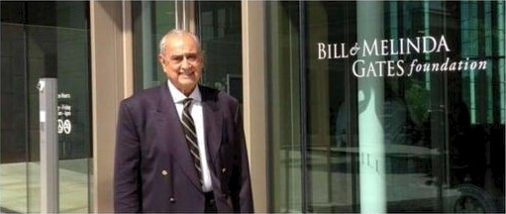
His Message to Us
“Don’t just grow your business, grow your country.” Syed Babar Ali

Slide 12
THANKS FOR YOUR TIME

